Slide 1
Pentose Phosphate Shunt and Glycogen Metabolism

Slide 2
Quiz Question #1
What process is the breakdown of glycogen to glucose in the cell?
Glycogenesis
Glycogenolysis
Glycolysis
Gluconeogenesis
Notes:
Answer is B

Slide 3
Quiz Question #2
Which is most true about glycogen synthase (GS) and glycogen phosphorylase (GP) activity and phosphorylation
Phosphorylation of both GP and GS increases activity
Phosphorylation of both GP and GS decreases activity
Phosphorylation increases the activity of GS but not GP
Phosphorylation increases the activity of GP but not GS
Notes:
Answer is B

Slide 4
Quiz Question #3
Why are red blood cells susceptible to oxidative damage
They generate a lot of mitochondrial reactive oxygen species
They carry very few antioxidants
The oxygen they carry can be very reactive
They cannot regenerate GSSG from NADPH
Notes:
Answer is C

Slide 5

The First Midterm
One week from Wednesday
Format
~2/3 multiple choice
~1/3 short answer
Questions based on
Lecture readings
Lecture material
Student presentations

Slide 6
Exam Preparation Suggestions
Review session next Monday
Make appointment to talk to me, Liv or Rina
Rina study group at 5PM Wednesday
Re-listen to lectures (all are recorded and posted)
Draw concept maps
Problem Roulette

Slide 7
Learning Objectives
Evaluate how the structure of glycogen allows for compact but accessible storage of glucose molecules.
Understand how glycogen synthesis and glycolysis are regulated by intracellular metabolites.
Explain how protein phosphorylation regulates glycogen synthase and glycogen phosphorylase activities and how extracellular signals affect glycogen metabolism.
Assess the tissue-specific roles of insulin, adrenaline and glucagon in glycogen storage.
Distinguish between the functions of glycogen in liver, adipose and muscle and evaluate how alterations in glycogen metabolism affect the physiological functions of these tissues.
Explain how glycogen storage diseases can occur and how specific genes result in different pathophysiologies depending on both the gene, and tissue where it is expressed.
Understand the role of Glucose-6-Phosphate Dehydrogenase in regulating flow through the pentose phosphate pathway.
Evaluate the role of glucose derived products in fatty acid and triglyceride synthesis.
Interpret how the combined regulation of glycolysis, glycogenesis and the pentose phosphate pathway can affect the ability to synthesize lipids.
Explain how defects in the pentose phosphate pathway can lead to disease.

Slide 8
Mitochondria and Oxidative Damage
Molecular Oxygen can form free oxygen radicals
2-4% of reactions lead to ROS
Can be scavenged and detoxified by SOD to peroxide
Then Catalase or Glutathione Peroxidase Converts to Water

Slide 9
Molecules Susceptible to Oxidative Damage
DNA – causes many long term effects (including aging)
Proteins – causes breakage of key disulfides needed for structure
Lipids – Especially Polyunsaturated Fatty Acids (PUFA)

Slide 10
Dietary Antioxidants
Free Radical Quenching
Vitamins C and E
Beta Carotene
Selenium
Cofactor for Glutathione Peroxidase
Lipid Soluble
Very Stable, nontoxic

Slide 11
Vitamin E Deficiency
Muscle Weakness and Loss of Muscle Mass
Neurological Problems
Vision Problems and Blindness
Sensory impairment
Hemolytic anemia due to loss of Red Blood Cells
Discuss what might be the mechanisms of these?

Slide 12
The Glutathione/NADPH System
Se Cofactor
Glutathione
Glutathione can be interconverted between oxidized (GSSG) and reduced (GSH) forms
It is regenerated from NADPH, generated from the pentose phosphate shunt

Slide 13
Pentose Phosphate Shunt

Slide 14
Pentose Phosphate Shunt
Ribose sugars for nucleotides
Important in Rapidly Dividing Cells which need nucleotides
Bone marrow, skin, epithelial cells of GI
NADPH
NADPH is an Antioxidant
Important for blood cells
Needed for FA biosynthesis
Also important in cells that make a lot of lipid
Mainly adipose and liver

Slide 15
Fatty Acid Synthesis Requires NADPH
Fatty Acid Synthesis
Consumes:
14 Malonyl CoA
7 Acetyl CoA (total of 21)
14 ATP (to make Malonyl CoA)
14 NADPH
Makes 1 Palmitate (C16:0)
Each Glucose-6-Phosphate in PPP
Generates 2 NADPH
Therefore you need 7 glucose molecules just to generate the NADPH for palmitate synthesis

Slide 16
Regulation of Pentose Phosphate Entry
First enzyme is the rate limiting and irreversible step
Glucose-6-Phosphate Dehydrogenase
Activated by its two substrates
NADP
Glucose-6-Phosphate
Inhibited by high levels of NADPH

Slide 17
G6PDH Deficiency and Favism
Red blood cells are especially susceptible to oxidative damage
Foods with oxidants in them can trigger hemolysis
Fava beans contain oxidants
Could extend for some to all legumes or oxidant medications (such as antimalarials)
Global prevalence 4.6%, 20% in Africa
May underlie Pythagoras’ ban on bean consumption
X-Linked genetics

Slide 18
GS
Glucose-6-Phosphate
Insulin/Glucagon
G6PDH
NADP/NADPH
Glucose-6-Phosphate
PFK1
Citrate
AMP/ATP
F26BP
Glucagon (liver)

Slide 19
Glycogen Metabolism

Slide 20
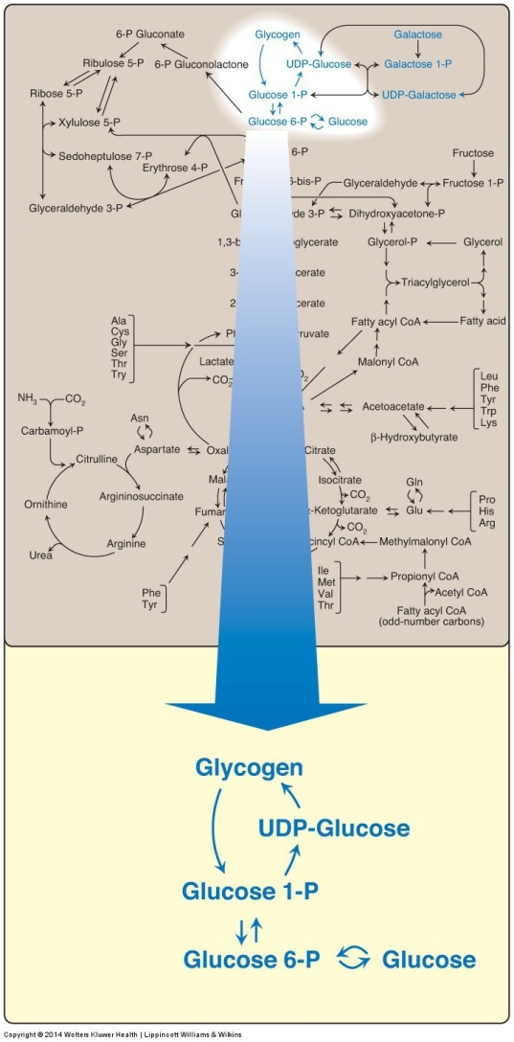
Glycogen Metabolism is Easy!
Glycogen Phosphorylase
Glycogen Synthase

Slide 21
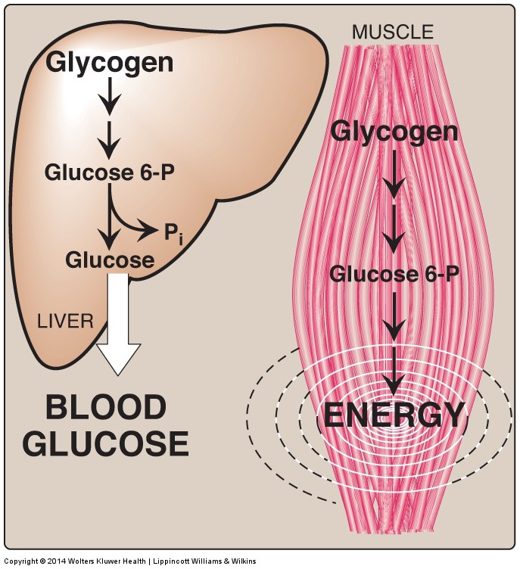
Tissue-Dependent Roles in Glycogen Metabolism
Notes:
What if G6Pase didn’t function correctly?

Slide 22
Why does liver release glucose but muscle utilizes it for energy?
Liver cannot use glucose for energy because it has no mitochondria
Liver cannot use glucose for energy because it has no PDH
Muscle cannot release glucose because of a lack of G6Pase
Muscle cannot release glucose because of a lack of GLUT4

Slide 23
Glycogen and Exercise

Slide 24
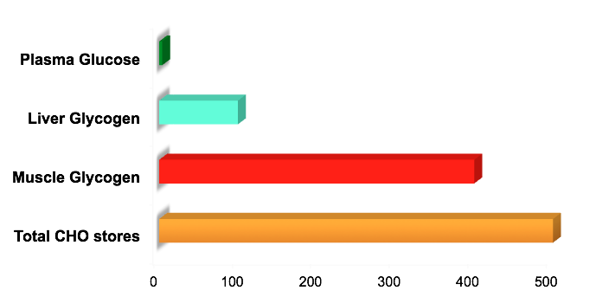
Glycogen Storage
Notes:
Wasserman, D.. Four grams of glucose. American Journal of Physiology- Endocrinology and Metabolism. 2009; 296: E11-E21.

Slide 25
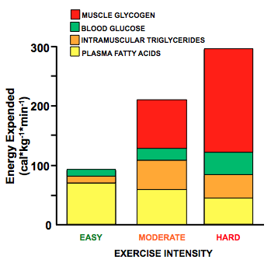
Source of Energy During Exercise
Notes:
Romijn, J., Coyle, E., Sidossis, L., Gastaldelli, A., Horowitz, J., Endert, E., & Wolfe, R. Regulation of endogenous fat and carbohydrate metabolism in relation to exercise intensity and duration. American Journal of Physiology- Endocrinology and Metabolism. 1993; 265(3): 380-91.

Slide 26
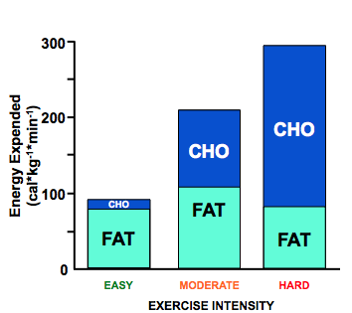
Source of Energy During Exercise
Notes:
Romijn, J., Coyle, E., Sidossis, L., Gastaldelli, A., Horowitz, J., Endert, E., & Wolfe, R. Regulation of endogenous fat and carbohydrate metabolism in relation to exercise intensity and duration. American Journal of Physiology- Endocrinology and Metabolism. 1993; 265(3): 380-91.

Slide 27
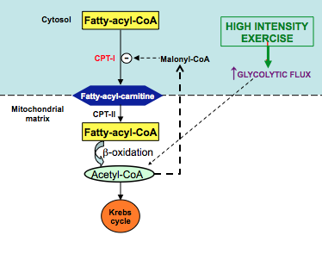
Pathway that Blocks Fat Oxidation at High Intensities
Notes:
Sidossis, L., Gastaldelli, A., Klein, S., & Wolfe, R. Regulation of plasma fatty acid oxidation during low- and high-intensity exercise. American Journal of Physiology- Endocrinology and Metabolism. 1997; 272(6): 1065-70.

Slide 28
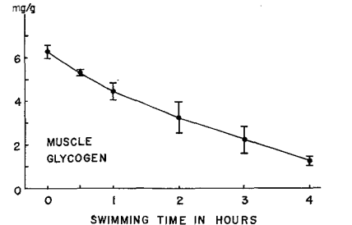
Muscle Glycogen Depletion During Exercise
Notes:
Armstrong, R., Saubert, C., Sembrowich, W., Shepherd, R., & Gollnick, P. Glycogen depletion in rat skeletal muscle fibers at different intensities and durations of exercise. Pflügers Archiv. 1974; 352: 243-256.

Slide 29
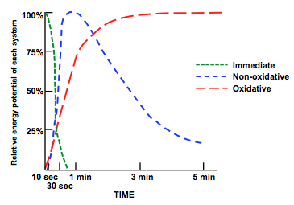
Pathways of ATP Production
Notes:
Karp, J. The three metabolic energy systems. IDEA Fitness Journal. 2009, 6(2), 26-29.

Slide 30
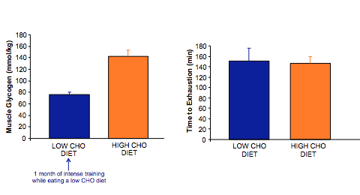
Low Carb Diet and Exercise Performance
Notes:
Phinney, S., Bistrian, B., Evans, W., Gervino, E., & Blackburn, G. The human metabolic response to chronic ketosis without caloric restriction: preservation of submaximal exercise capability with reduced carbohydrate oxidation. Metabolism. 1993, 32(8), 769-76

Slide 31
Structure of Glycogen
Notes:
Why do you think there are all these branches?

Slide 32
What polysaccharide is glycogen most similar to?
Amylose
Amylopectin
Cellulose
Glucose
Notes:
Answer is B amylopectin

Slide 33
How To Remove Branch Points
This is catalyzed by a single enzyme called AGL
What are some advantages of branching?

Slide 34
Cori’s Disease
Mutations in debranching enzyme (AGL)
Single gene in all tissues, autosomal recessive
Mutations result in:
Buildup of highly branched glycogen
Hypoglycemia
Hepatomegaly (enlarged liver)
Hyperlipidemia
Poor muscle tone (hypotonia)
Muscle degeneration (myopathy)
Weakened hearts (cardiomyopathy)
Can affect muscle/liver/heart differentially, unknown why

Slide 35
Glycogen Storage Diseases Exercise

Slide 36
Regulation of Glycogenolysis

Slide 37
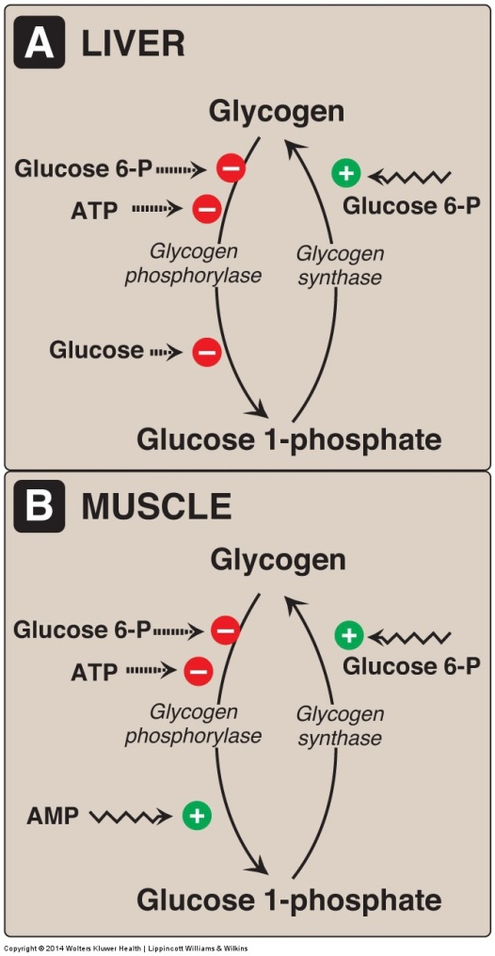
Glycogen Phosphorylase Releases Most Glucose Molecules
Note that muscle and liver have different isoforms of glycogen phosphorylase and therefore can be regulated differently.
Why are these differences advantageous?

Slide 38
Glucagon and Epinephrine
Quick review

Slide 39
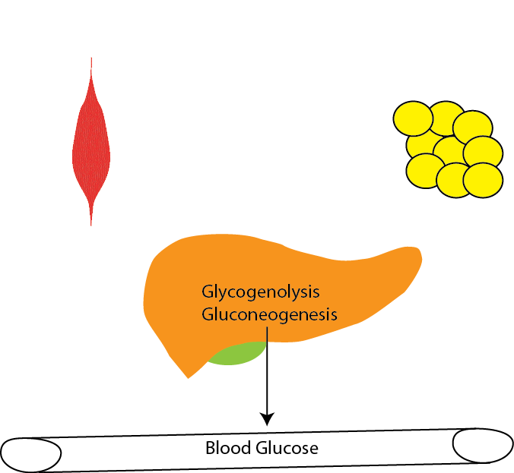
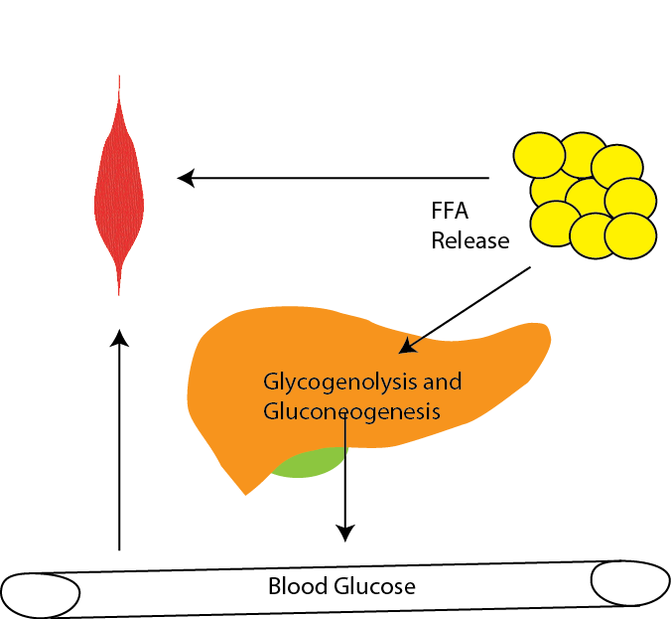
Physiology of Glucagon vs Adrenaline
Glucagon
Epinephrine
Raise Blood Glucose
Provide Glucose to Muscle

Slide 40
Adrenergic Signaling Effects on Glucose/Glycogen
Glucagon
Epinephrine
Liver
Blocks glycolysis (PFK2/PK)
Stimulates gluconeogenesis (FBPase)
Blocks glycogenesis (GS/PhA)
Stimulates glycogenolysis (GS/PhA)
Muscle/Fat
Very little effect on anything almost no Glucagon receptors
Liver
Blocks glycolysis (PFK2/PK)
Stimulates gluconeogenesis (FBPase)
Blocks glycogenesis (GS/PhA)
Stimulates glycogenolysis (GS/PhA)
Muscle/Fat
Positive effect on glycolysis
No appreciable gluconeogenesis
Blocks glycogenesis (GS/PhA)
Stimulates glycogenolysis (GS/PhA)

Slide 41
Why does adrenaline not suppress glycolysis in muscle
Muscle doesn’t have PFK-2 activity
Adrenaline do not activate PKA in muscle
Muscle PK/PFK-2 can’t be phosphorylated by PKA
There are no Adrenaline receptors in muscle

Slide 42
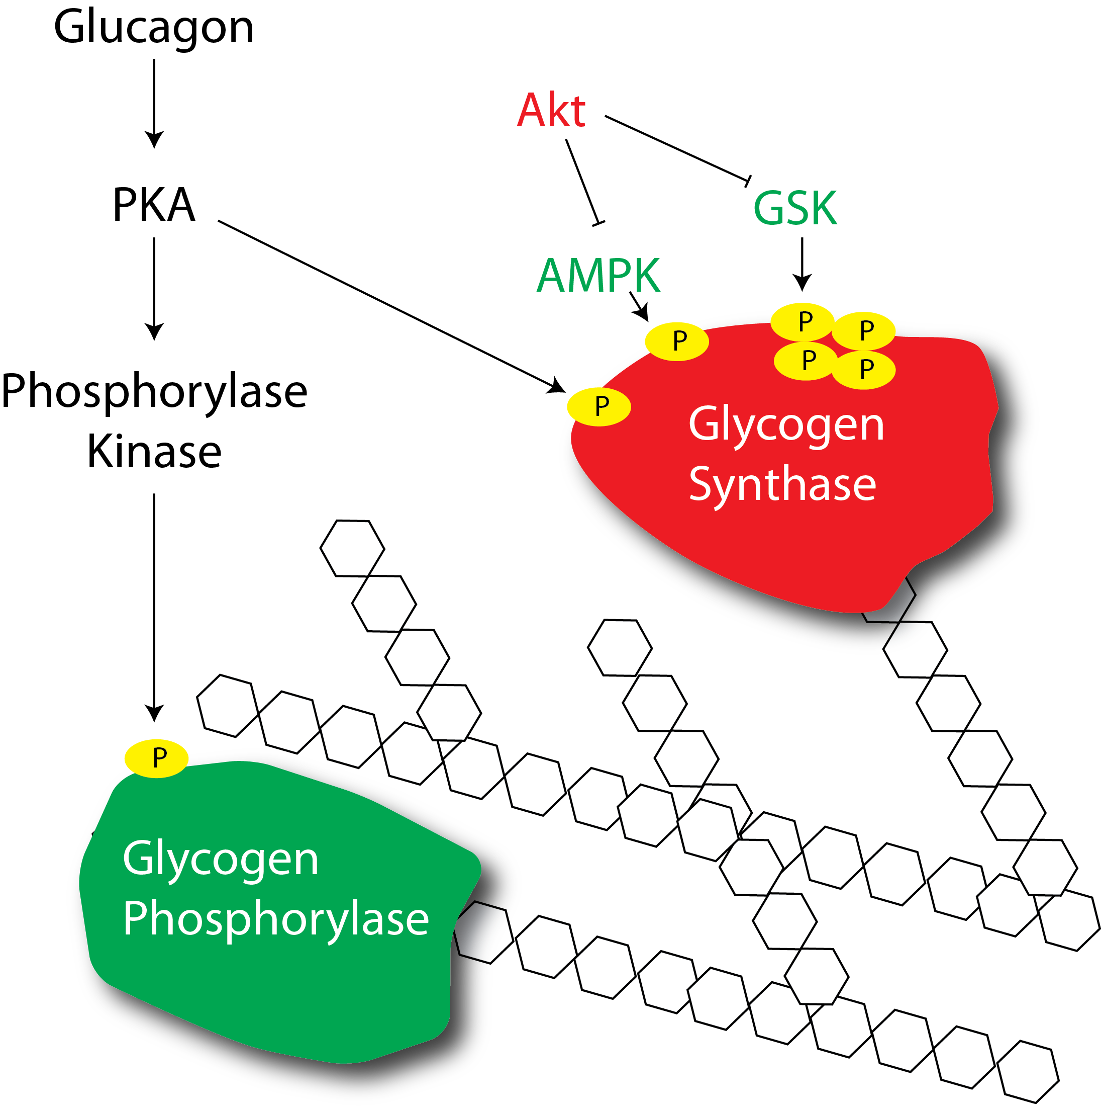
How does glucagon or adrenaline regulate glycogenolysis?

Slide 43
Defects in glycogen phosphorylase
Muscle phosphorylase
Liver phosphorylase
McArdle’s disease
Rhabdomyolysis
Second wind phenomena
Treated by high protein diets
Her’s disease
Hypoglycemia
Hepatomegaly
Hyperlipidemia
Treated by avoiding fasting, or frequent dextrose/cornstarch feeding through the night
Notes:
Second wind is due to increased ability to use lipids and proteins as an energy source, but these take some time to mobilize (usually feel better after about 10 mins of aerobic exercise)

Slide 44
Insulin

Slide 45
Glycogenesis is Regulated by Hormones and Metabolites
What would be the benefit of positive regulation by Glucose-6-Phosphate?
Notes:
Hypoglycemia
Ketosis
Failure to thrive

Slide 46
In muscle what else could cause increases in Glucose-6-phosphate levels?
Insulin stimulation of glucose transport
Insulin stimulation of glycolysis
Insulin stimulation of pentose phosphate
Insulin stimulation of gluconeogenesis

Slide 47
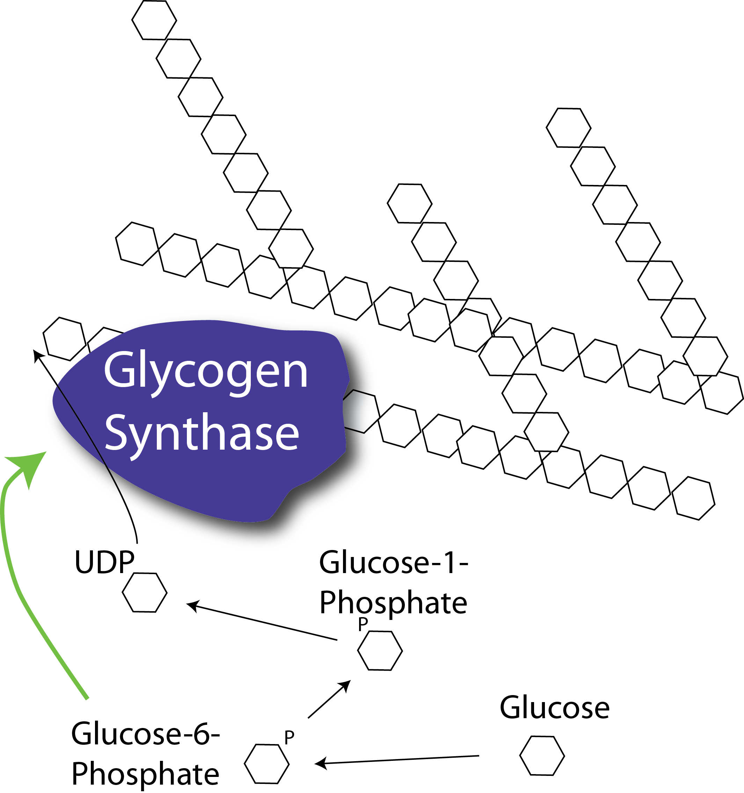
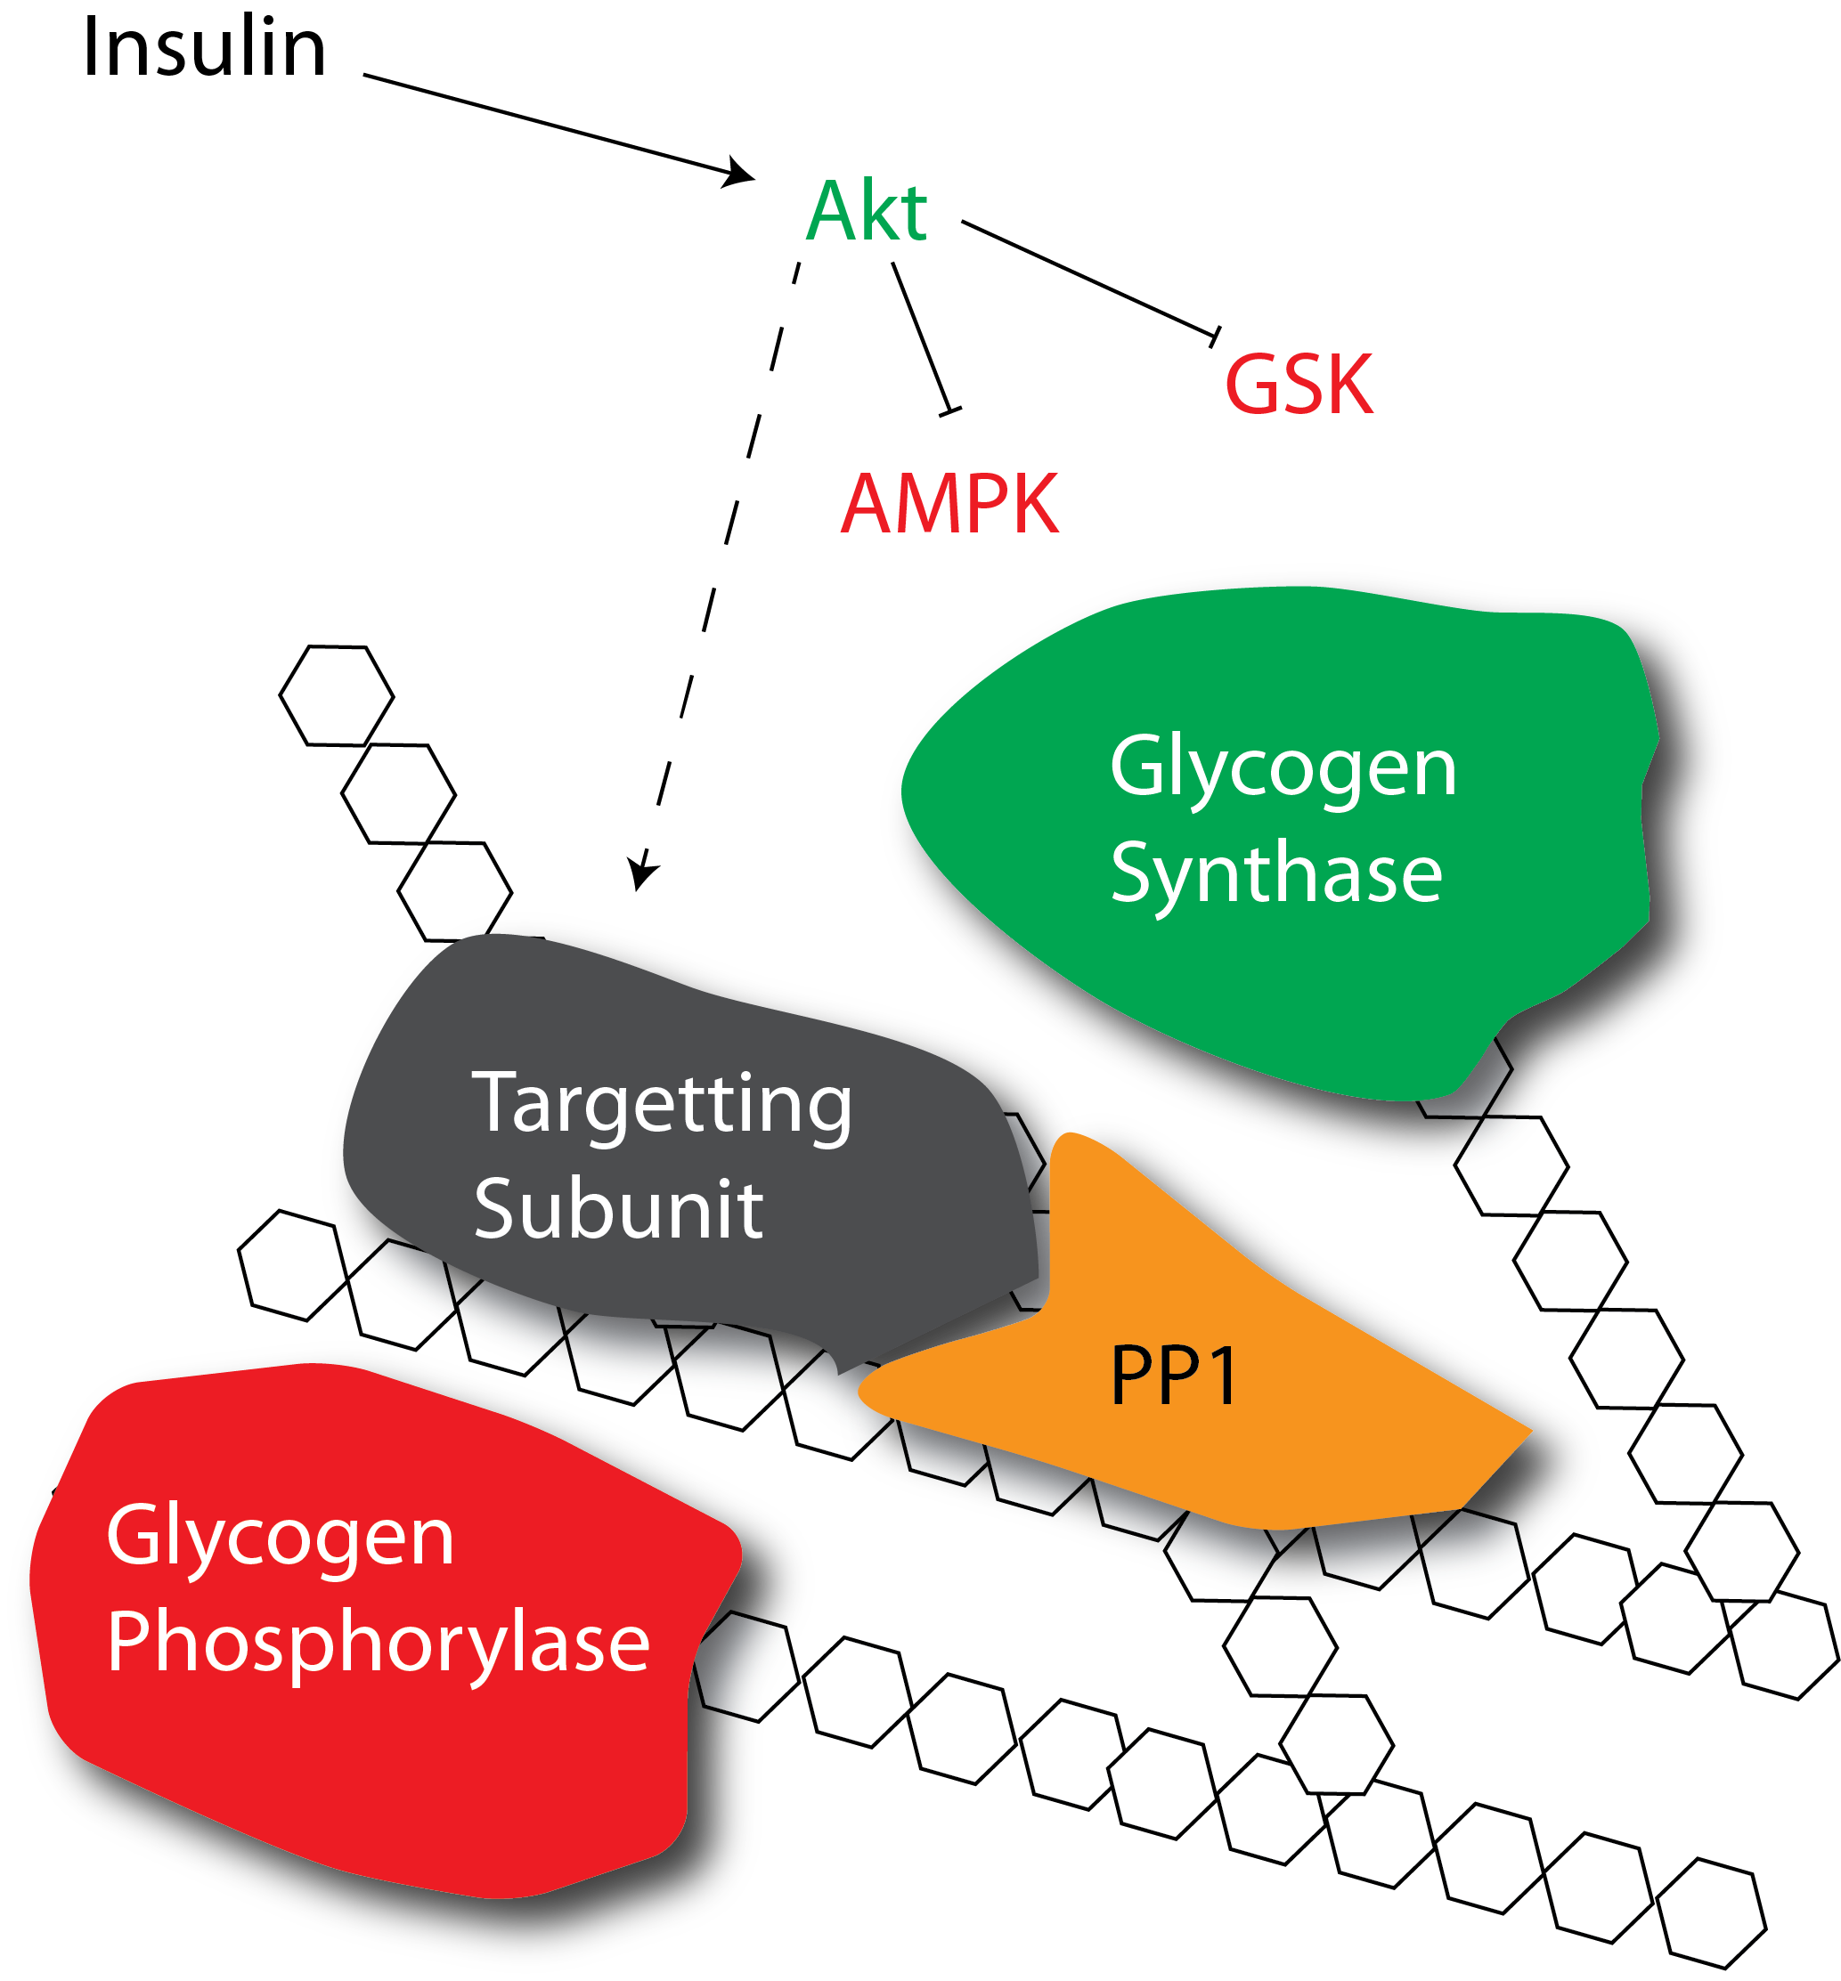
How does insulin promote glycogenesis?
Allosteric activation
Protein dephosphorylation
Notes:
First ask about which mediators are increased with insulin, or see what the allosteric activation of GS looks like

Slide 48
Glycogen storage has limited feedback to suppress glycogenesis
Glycogen supercompensation

Slide 49
Learning Objectives
Evaluate how the structure of glycogen allows for compact but accessible storage of glucose molecules.
Understand how glycogen synthesis and glycolysis are regulated by intracellular metabolites.
Explain how protein phosphorylation regulates glycogen synthase and glycogen phosphorylase activities and how extracellular signals affect glycogen metabolism.
Assess the tissue-specific roles of insulin, adrenaline and glucagon in glycogen storage.
Distinguish between the functions of glycogen in liver, adipose and muscle and evaluate how alterations in glycogen metabolism affect the physiological functions of these tissues.
Explain how glycogen storage diseases can occur and how specific genes result in different pathophysiologies depending on both the gene, and tissue where it is expressed.
Understand the role of Glucose-6-Phosphate Dehydrogenase in regulating flow through the pentose phosphate pathway.
Evaluate the role of glucose derived products in fatty acid and triglyceride synthesis.
Interpret how the combined regulation of glycolysis, glycogenesis and the pentose phosphate pathway can affect the ability to synthesize lipids.
Explain how defects in the pentose phosphate pathway can lead to disease.

